Slide 1
ECE314 Lab 6 Overview
Random walks

Slide 2

Random process
Random variable
$$X_{1}$$
$$X_{2} X_{3} X_{4} X_{5} X_{6} X_{7} X_{8} X_{9} X_{10} ⋯$$
Random process

Slide 3









Random walk
steps
$$+X_{1}$$
$$+X_{2}$$
$$+X_{3}$$
$$+X_{4}$$
$$+X_{5}$$
$$0$$
$$S_{1}$$
$$S_{2} S_{3} S_{4} S_{5} ⋯$$
Random walk
$$S_{n}=X_{1}+⋯+X_{n}$$

Slide 4




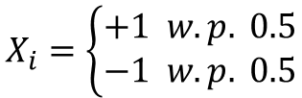













Random walk: examples
Steps are i.i.d. and are independent of time
$$X_{i}=\left\{\begin{aligned}+1 w.p. 0.5 \\ −1 w.p. 0.5\end{aligned}\right.$$
$$S_{n}=X_{1}+⋯+X_{n}$$
$$−7$$
$$−6$$
$$−5$$
$$−4$$
$$−3$$
$$−2$$
$$−1$$
$$0$$
$$1$$
$$2$$
$$3$$
$$4$$
$$5$$
$$6$$
$$7$$

Slide 5

Random walk: examples
Steps are i.i.d. and are independent of time
$$X_{i}=\left\{\begin{aligned}+1 w.p. 0.5 \\ −1 w.p. 0.5\end{aligned}\right.$$
$$S_{n}=X_{1}+⋯+X_{n}$$
$$X_{1}=1$$
$$−7$$
$$−6$$
$$−5$$
$$−4$$
$$−3$$
$$−2$$
$$−1$$
$$0$$
$$1$$
$$2$$
$$3$$
$$4$$
$$5$$
$$6$$
$$7$$

Slide 6
Random walk: examples
Steps are i.i.d. and are independent of time
$$X_{i}=\left\{\begin{aligned}+1 w.p. 0.5 \\ −1 w.p. 0.5\end{aligned}\right.$$
$$S_{n}=X_{1}+⋯+X_{n}$$
$$X_{1}=1$$
$$−7$$
$$−6$$
$$−5$$
$$−4$$
$$−3$$
$$−2$$
$$−1$$
$$0$$
$$1$$
$$2$$
$$3$$
$$4$$
$$5$$
$$6$$
$$7$$

Slide 7

Random walk: examples
Steps are i.i.d. and are independent of time
$$X_{i}=\left\{\begin{aligned}+1 w.p. 0.5 \\ −1 w.p. 0.5\end{aligned}\right.$$
$$S_{n}=X_{1}+⋯+X_{n}$$
$$X_{2}=1$$
$$−7$$
$$−6$$
$$−5$$
$$−4$$
$$−3$$
$$−2$$
$$−1$$
$$0$$
$$1$$
$$2$$
$$3$$
$$4$$
$$5$$
$$6$$
$$7$$

Slide 8
Random walk: examples
Steps are i.i.d. and are independent of time
$$X_{i}=\left\{\begin{aligned}+1 w.p. 0.5 \\ −1 w.p. 0.5\end{aligned}\right.$$
$$S_{n}=X_{1}+⋯+X_{n}$$
$$X_{2}=1$$
$$−7$$
$$−6$$
$$−5$$
$$−4$$
$$−3$$
$$−2$$
$$−1$$
$$0$$
$$1$$
$$2$$
$$3$$
$$4$$
$$5$$
$$6$$
$$7$$

Slide 9

Random walk: examples
Steps are i.i.d. and are independent of time
$$X_{i}=\left\{\begin{aligned}+1 w.p. 0.5 \\ −1 w.p. 0.5\end{aligned}\right.$$
$$S_{n}=X_{1}+⋯+X_{n}$$
$$X_{3}=−1$$
$$−7$$
$$−6$$
$$−5$$
$$−4$$
$$−3$$
$$−2$$
$$−1$$
$$0$$
$$1$$
$$2$$
$$3$$
$$4$$
$$5$$
$$6$$
$$7$$

Slide 10
Random walk: examples
Steps are i.i.d. and are independent of time
$$X_{i}=\left\{\begin{aligned}+1 w.p. 0.5 \\ −1 w.p. 0.5\end{aligned}\right.$$
$$S_{n}=X_{1}+⋯+X_{n}$$
$$X_{3}=−1$$
$$−7$$
$$−6$$
$$−5$$
$$−4$$
$$−3$$
$$−2$$
$$−1$$
$$0$$
$$1$$
$$2$$
$$3$$
$$4$$
$$5$$
$$6$$
$$7$$

Slide 11

Random walk: examples
Steps are i.i.d. and are independent of time
$$X_{i}=\left\{\begin{aligned}+1 w.p. 0.5 \\ −1 w.p. 0.5\end{aligned}\right.$$
$$S_{n}=X_{1}+⋯+X_{n}$$
$$X_{4}=1$$
$$−7$$
$$−6$$
$$−5$$
$$−4$$
$$−3$$
$$−2$$
$$−1$$
$$0$$
$$1$$
$$2$$
$$3$$
$$4$$
$$5$$
$$6$$
$$7$$

Slide 12
Random walk: examples
Steps are i.i.d. and are independent of time
$$X_{i}=\left\{\begin{aligned}+1 w.p. 0.5 \\ −1 w.p. 0.5\end{aligned}\right.$$
$$S_{n}=X_{1}+⋯+X_{n}$$
$$X_{4}=1$$
$$−7$$
$$−6$$
$$−5$$
$$−4$$
$$−3$$
$$−2$$
$$−1$$
$$0$$
$$1$$
$$2$$
$$3$$
$$4$$
$$5$$
$$6$$
$$7$$

Slide 13

Random walk: examples
Steps are i.i.d. and are independent of time
$$X_{i}=\left\{\begin{aligned}+1 w.p. 0.5 \\ −1 w.p. 0.5\end{aligned}\right.$$
$$S_{n}=X_{1}+⋯+X_{n}$$
$$X_{5}=1$$
$$−7$$
$$−6$$
$$−5$$
$$−4$$
$$−3$$
$$−2$$
$$−1$$
$$0$$
$$1$$
$$2$$
$$3$$
$$4$$
$$5$$
$$6$$
$$7$$

Slide 14
Random walk: examples
Steps are i.i.d. and are independent of time
$$X_{i}=\left\{\begin{aligned}+1 w.p. 0.5 \\ −1 w.p. 0.5\end{aligned}\right.$$
$$S_{n}=X_{1}+⋯+X_{n}$$
$$X_{5}=1$$
$$−7$$
$$−6$$
$$−5$$
$$−4$$
$$−3$$
$$−2$$
$$−1$$
$$0$$
$$1$$
$$2$$
$$3$$
$$4$$
$$5$$
$$6$$
$$7$$

Slide 15
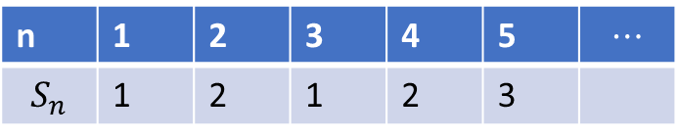
Random walk: examples
Steps are i.i.d. and are independent of time
$$X_{i}=\left\{\begin{aligned}+1 w.p. 0.5 \\ −1 w.p. 0.5\end{aligned}\right.$$
$$S_{n}=X_{1}+⋯+X_{n}$$
$$X_{5}=1$$
$$−7$$
$$−6$$
$$−5$$
$$−4$$
$$−3$$
$$−2$$
$$−1$$
$$0$$
$$1$$
$$2$$
$$3$$
$$4$$
$$5$$
$$6$$
$$7$$
n | 1 | 2 | 3 | 4 | 5 | $$⋯$$
$$S_{n}$$ | 1 | 2 | 1 | 2 | 3

Slide 16
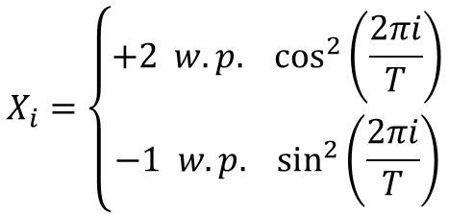
Random walk: examples
Steps are mutually independent but depend on time
$$X_{i}=\left\{\begin{aligned}+2 w.p. \cos^{2}\left(\frac{2πi}{T}\right) \\ −1 w.p. \sin^{2}\left(\frac{2πi}{T}\right)\end{aligned}\right.$$
$$S_{n}=X_{1}+⋯+X_{n}$$

Slide 17
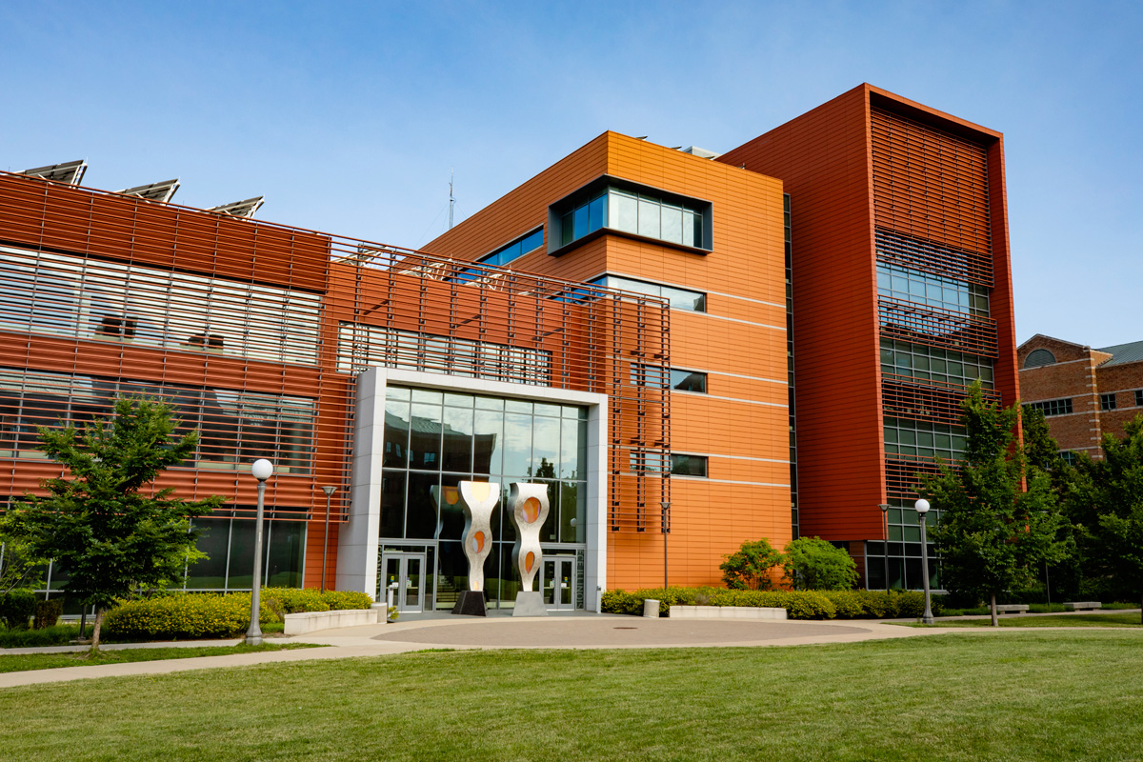

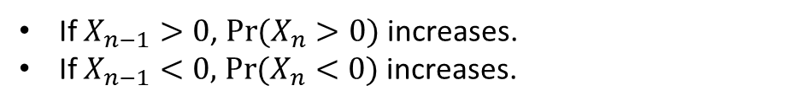
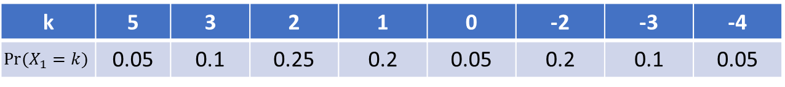



Random walk: examples
A zombie game
A step is affected by the previous step.
$$S_{n}$$
$$S_{n}=X_{1}+⋯+X_{n}$$
$$S_{0}=20$$
k | 5 | 3 | 2 | 1 | 0 | -2 | -3 | -4
$$\operatorname{Pr}{(X_{1}=k)}$$ | 0.05 | 0.1 | 0.25 | 0.2 | 0.05 | 0.2 | 0.1 | 0.05
$$X_{n}$$
If $X_{n−1}>0$, $\operatorname{Pr}{(X_{n}>0)}$ increases.
If $X_{n−1}<0,$ $\operatorname{Pr}{(X_{n}<0)}$ increases.

